Slide 1
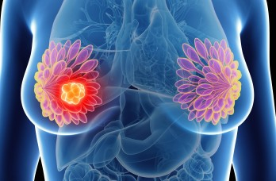
The Cancer Miracle! It’s Not a Cure – It’s Prevention
Tom Pool, MPH, DVM, DACVPM
21 November 2019

Slide 2
What is Cancer?
In the next 5 years cancer will be #1 killer in US.
Two 19th century surgeons named cancer “The King of Terrors” & “The Emperor of Maladies.”
Mostly a disease of aging, we now live to see it…a nightmare that will take one in three of us.
Treatments improving but will never catch up.
Heart disease tamed – Smoking, diet, exercise.
Infectious disease – Sanitation, vacs, antibiotics.
But cancer increasing fast. It’s an emergency.

Slide 3
It’s In Our DNA
Notes:
Blood cell from 100 year old person has on average 4,000 errors in the genes of that cell. Not deadly, yet. Eyelid cells from middle age men have 60-180 errors from sunlight.

Slide 4
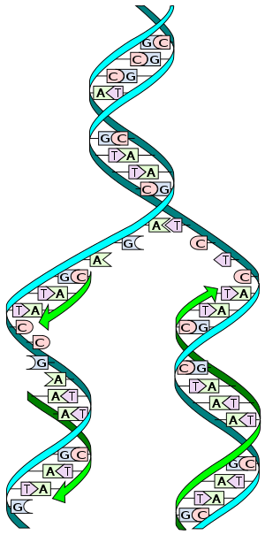
What is Cancer?
Accum. errors in DNA replication.
There are causes & bad luck.
Proof-checking catches errors.
37 trillion cells, all dividing…
Notes:
Blood cell from 100 year old person has on average 4,000 errors in the genes of that cell. Not deadly, yet. Eyelid cells from middle age men have 60-180 errors from sunlight.

Slide 5
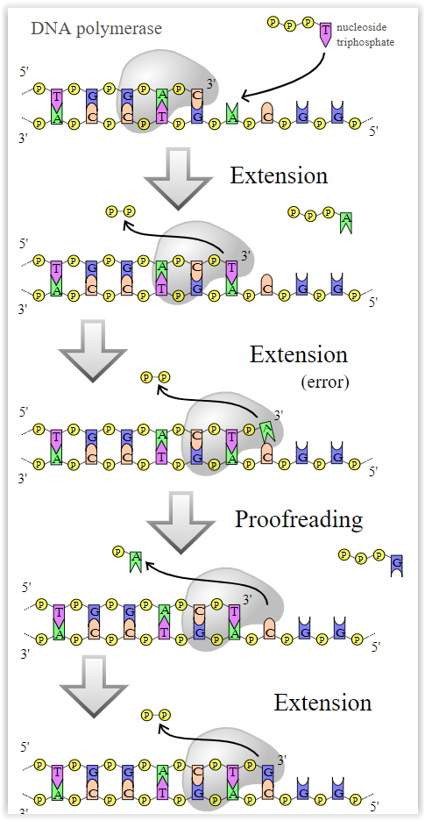
What is Cancer?
Accum. errors in DNA replication.
There are causes & bad luck.
Proof-checking catches errors.
Notes:
Blood cell from 100 year old person has on average 4,000 errors in the genes of that cell. Not deadly, yet. Eyelid cells from middle age men have 60-180 errors from sunlight.

Slide 6
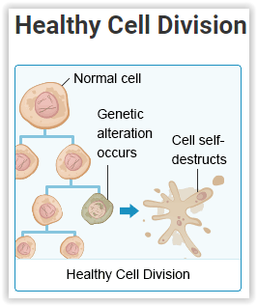
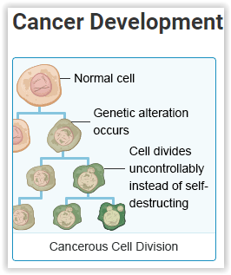
What is Cancer?
Accum. errors in DNA replication.
There are causes & bad luck.
Proof-checking catches errors.
Notes:
Blood cell from 100 year old person has on average 4,000 errors in the genes of that cell. Not deadly, yet. Eyelid cells from middle age men have 60-180 errors from sunlight.

Slide 7
What is Cancer?
Accum. errors in DNA replication.
There are causes & bad luck.
Proof-checking catches errors.
Immune system nukes them.
But not always. Errors add up.
3 billion letters in genome.
Even 1 error per million, 3 thou.
As we age, errors accumulate.
Cancer wards: Young & old.
Notes:
Blood cell from 100 year old person has on average 4,000 errors in the genes of that cell. Not deadly, yet. Eyelid cells from middle age men have 60-180 errors from sunlight.

Slide 8
Why is Cancer Increasing?
#1….diet. More meat, less fruits & vegs.
Arguably higher exposure to carcinogens.
Good news: < Smoking. 1965-42%, now-13%.
About 1/3 just bad luck. Trillions of divisions…trillions of potential typing errors.
Living longer – typing errors accumulate.
Cancer not one error, many. Like division rate or life span or ability to evade immune system.
Cancers there for ~ 20 years before takes off.
Perhaps 70% of cancers are avoidable!

Slide 9
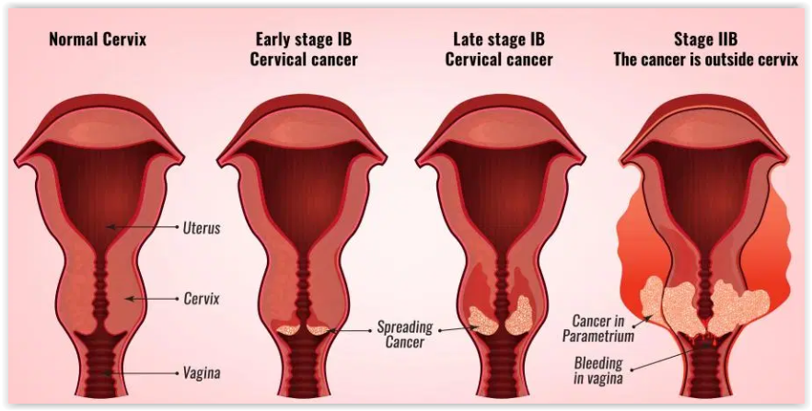
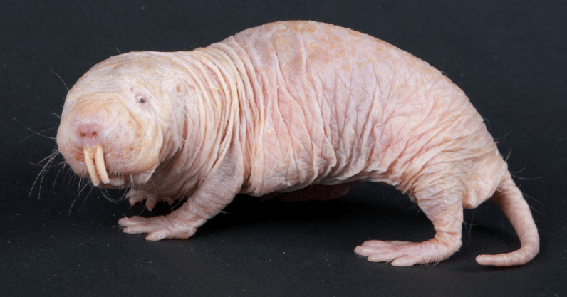
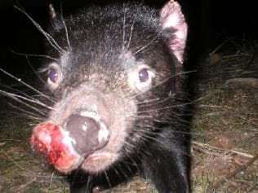
Cancer Mysteries
Sharks get cancer, but rarely. Mole rats don’t.
Tasmanian devils get contagious cancer.
Humans too. Cervix – HPV, Liver – Hep B, C.

Slide 10
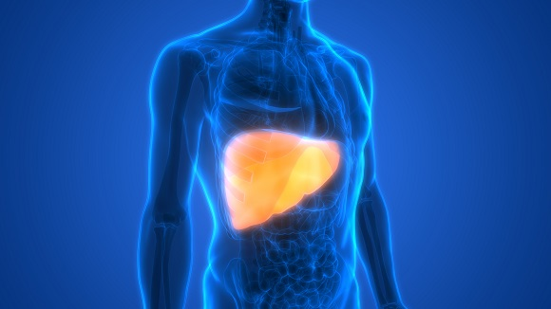
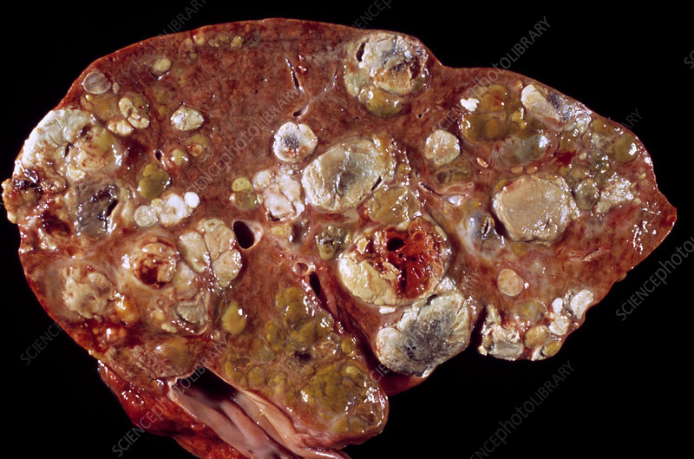
Cancer Mysteries
Sharks get cancer, but rarely. Mole rats don’t.
Tasmanian devils get contagious cancer.
Humans too. Cervix – HPV, Liver – Hep B, C.

Slide 11
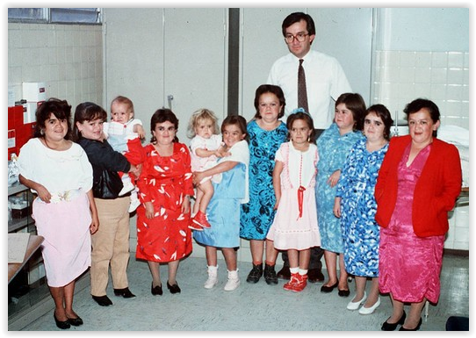
Cancer Mysteries
Laron Syndrome dwarves – No cancer.

Slide 12
Methionine and Cancer
Amino acids are building blocks of proteins.
Methionine is an essential amino acid, but…
Restricting methionine reliably promotes longevity of lab animals by >40%.
That same restriction seems to significantly improve efficacy of cancer chemotherapy.
New study from Duke Univ. in “Nature” found significant improvement in human cancer patients from methionine restricted diet.
May be the key to calorie restriction & longevity.

Slide 13
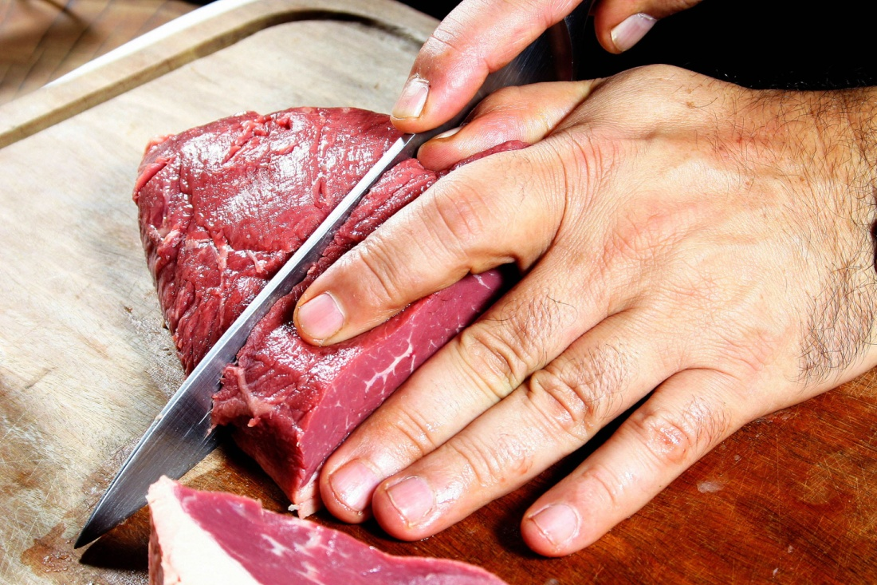
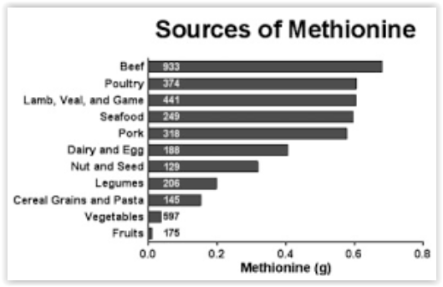
So, Should We Eat Less Methionine?
Probably. Almost certainly.
Richest sources - red meats, poultry, fish.
Dairy/Eggs have about 2/3 as much.
Beans about 1/3 as much.
Fruits and other vegetables, almost none.

Slide 14
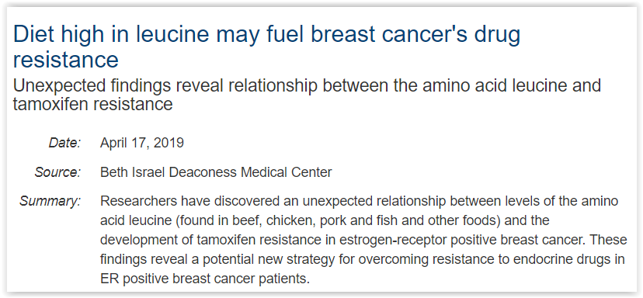
Leucine and Cancer
Almost same story as methionine.
Essential amino acid, highest sources: meats.

Slide 15
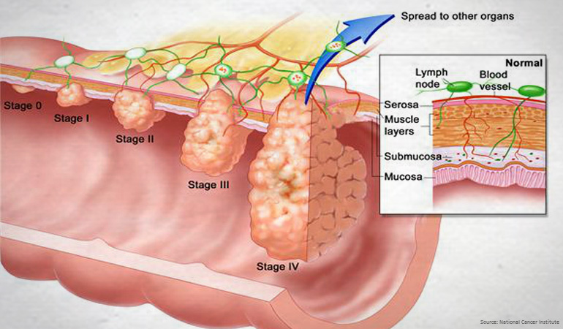
What To Do…
Stop smoking, lose weight, eat less meat, lots more fruits, vegs, whole grains.
Get colonoscopy every 10 years.

Slide 16
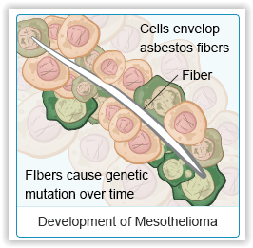
What To Do…
Stop smoking, lose weight, eat less meat, lots more fruits, vegs, whole grains.
Get colonoscopy every 10 years.
Vacc. kids for HPV and Hep B!!!
Get regular exercise. Walking 21 min/day enuf.
Regular check-ups: skin, breasts, cervix, prostate, etc.
Avoid inflammation…sugar, asbestos: C-RePro

Slide 17
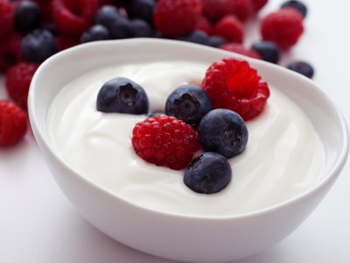
What To Do…
Stop smoking, lose weight, eat less meat, lots more fruits, vegs, whole grains.
Get colonoscopy every 10 years.
Vacc. kids for HPV and Hep B!!!
Get regular exercise. Walking 21 min/day enuf.
Regular check-ups: skin, breasts, cervix, prostate, etc.
Avoid inflammation…sugar, asbestos: C-RePro
Eat cultured products daily: Yogurt, cot. cheese.

Slide 18
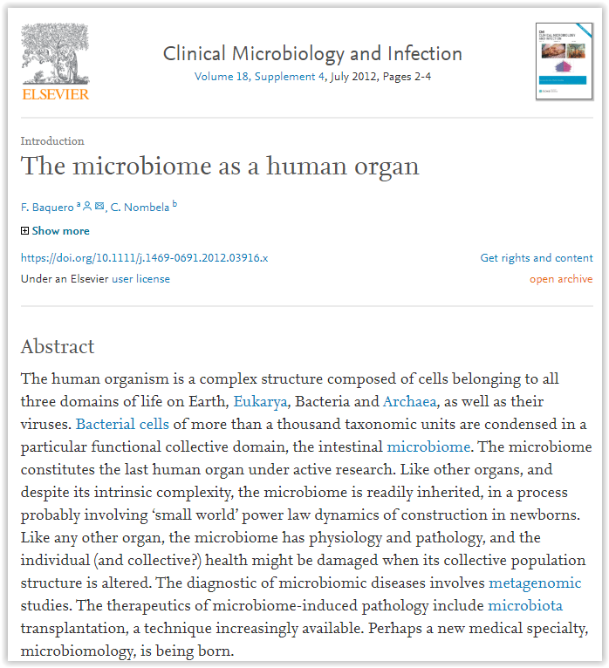
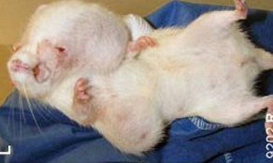
Your Microbiome Can Save You
C3H/H3 tumor mouse: Spontaneous tumors
Sterile guts: 30% dev. tumors in 1 year.
E. coli guts: 100% dev. tumors in 1 year.
E. coli + yogurt orgs: 47% dev. tumors 1 year - constitutes a 75% reduction in risk.

Slide 19
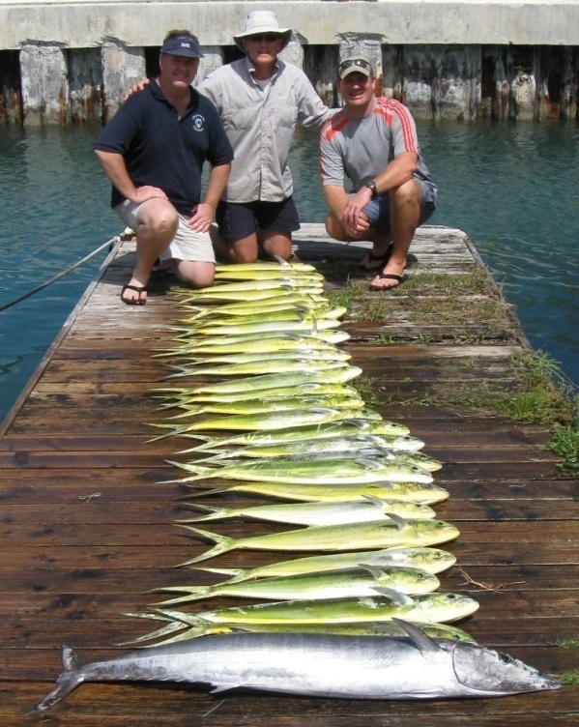
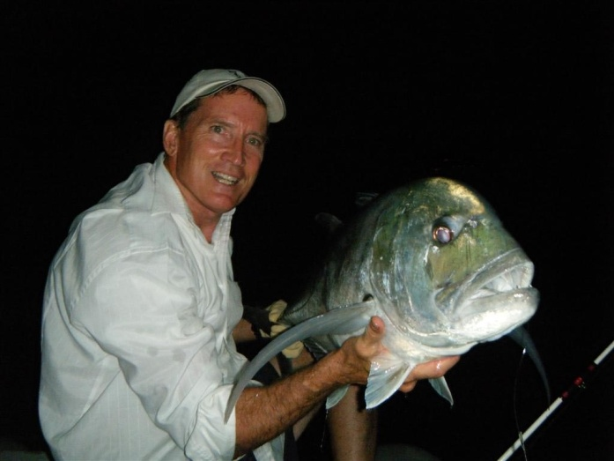
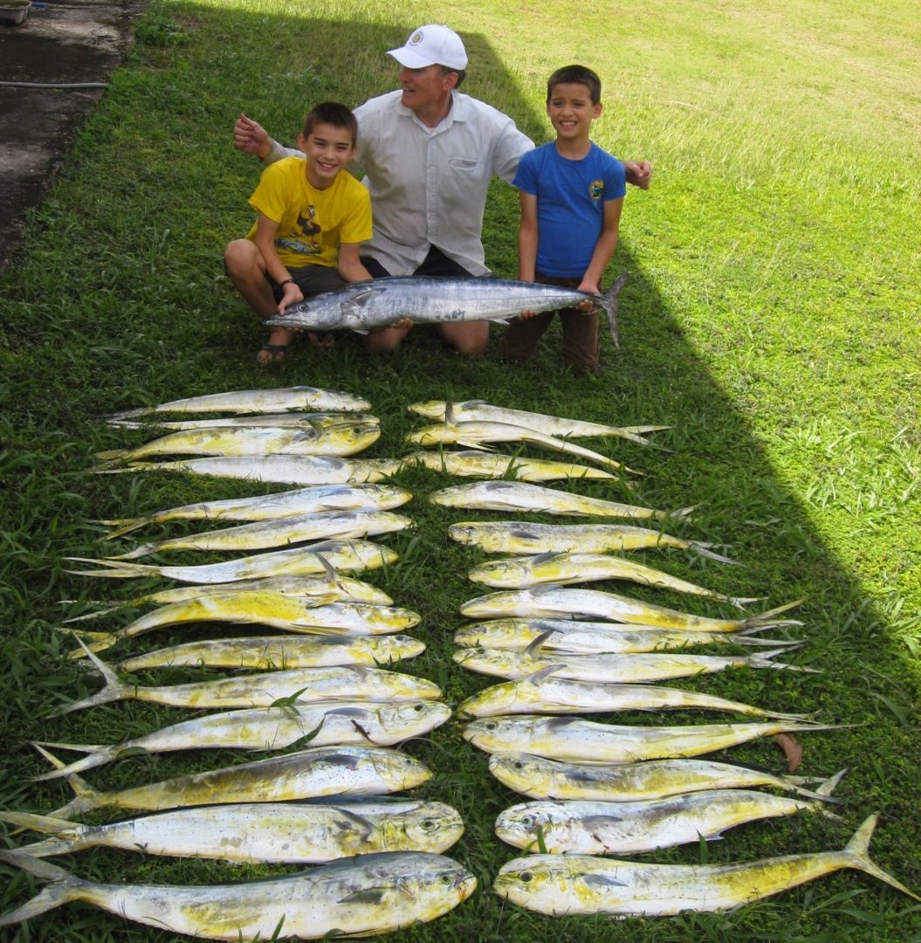
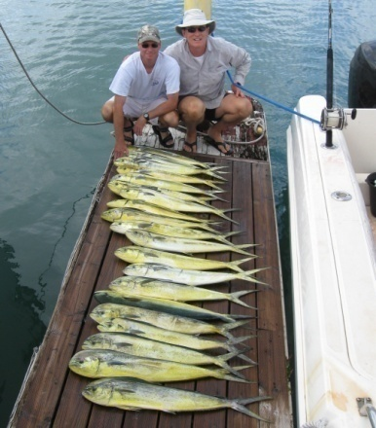
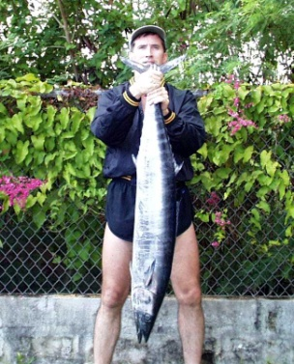
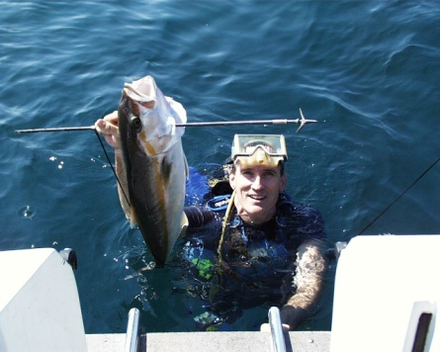
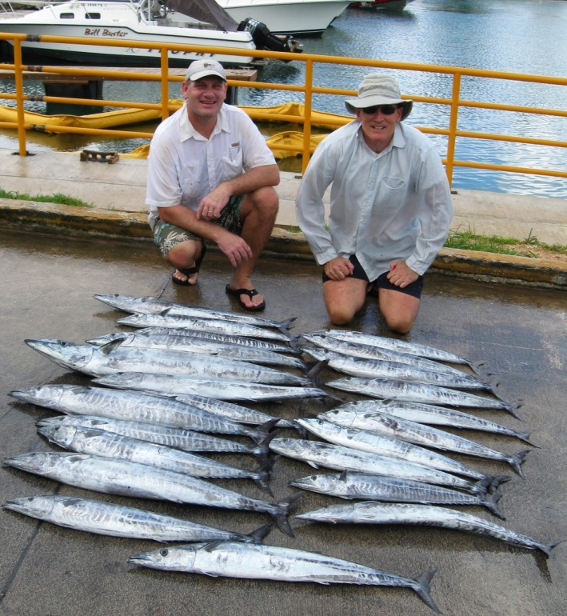
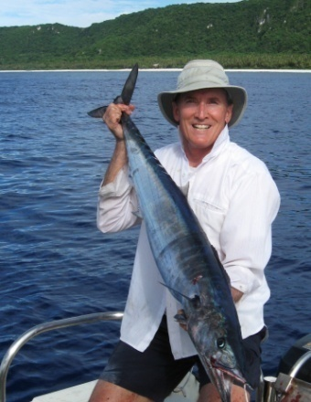
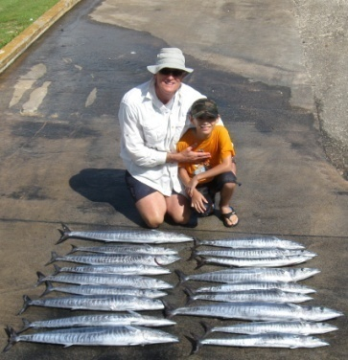
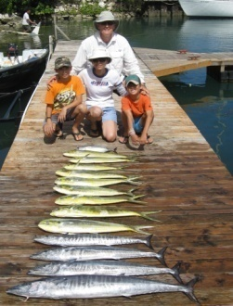
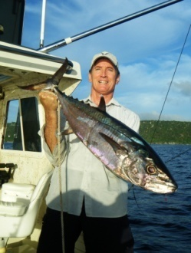
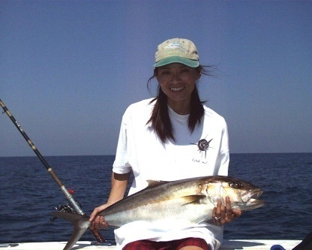
End

Slide 20
What To Do…
Stop smoking, lose weight, eat less meat, lots more fruits, vegs, whole grains.
Get colonoscopy every 10 years.
Vacc. kids for HPV and Hep B!!!
Get regular exercise. Walking 21 min/day enuf.
Regular check-ups: skin, breasts, cervix, prostate, etc.
Eat cultured products daily: Yogurt, cot. cheese.

